Slide 1
IKI Small Grants
Gender in project applications
2024

Slide 2
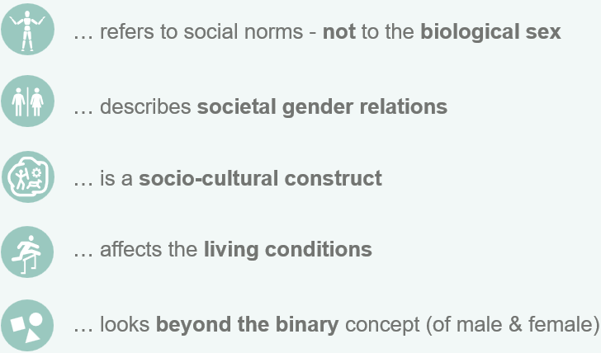
Why consider gender in your project?
No project is gender-neutral!
1
Reduces risk of negative impacts
Gender…
Paying attention to gender roles and norms is required to prevent gender-based discrimination, disadvantages or violence in the project context.
2
Improves your results
Equal opportunities and equal participation for all social groups enhance the precision, ambition, quality, efficiency and sustainability of project measures, thus making them more effective.

Slide 3
What is gender mainstreaming?
Gender…
Gender mainstreaming is a strategic approach to reviewing and improving the impact of organisational actions on gender justice.

Slide 4
What is the gender goal of the IKI?
IKI SMALL GRANTS PROJECTS
GENDER NEGATIVE | GENDER BLIND | GENDER SENSITIVE | GENDER RESPONSIVE | GENDER TRANSFORMATIVE
Unequal gender roles, relations and norms are upheld. | Ignores unequal gender roles, relations and norms and gender-based discrimination. | Recognises unequal gender roles, relations and norms, but does not actively address them. | Recognises unequal gender roles, relations and norms and attempts to actively combat them. | Addresses the deep roots of unequal gender roles, relations and norms.
Please note: Gender responsive or transformative project proposals are highly encouraged and will be considered with priority. However, we are aware of the potential constraints and challenges you might be facing. Thus, we recommend to integrate the suggestions below wherever possible and openly communicate obstacles (e. g. data availability, lack of resources or expertise). Reflecting on limitations is not a disadvantage in the selection process.

Slide 5
REACH
BENEFIT
EMPOWER
Approach | Gender sensitive | Gender responsive | Gender transformative
Activities | Include women* in design of program activities | Design trainings that consider gendered needs, preferences & constraints to ensure that everyone benefits | Strengthen abilities of all genders to make strategic life choices & put those choices into action
 | Invite women* as participants | Women* make use of the learned skills, techniques, know how, etc. | Enhancing women‘s decision making power in households/ communities/politics by challenging gender roles/ norms
Indicators | Number and proportion of participants successfully completing a training | Sex-disaggregated data for indicators, e. g. increase of yields/income | More equal decision-making power, e. g. in income use, agricultural production, reduction in time burden
* By inclusion we mean that usually underrepresented groups participate as well. In many cases this will refer to women and gender minorities. However, targeting men as agents of change can be a powerful approach. True inclusion is intersectional (i. e. considers factors like age, social background, ethnicity, etc.).
Notes:
Source: adapted from Reach, benefit, or empower: Clarifying gender strategies of development projects | IFPRI : International Food Policy Research Institute

Slide 6
How to integrate gender in your project proposal?
Step 1: Analyse your context & target group
Guiding questions
?
What are gender differences in your project context in terms of roles and responsibilities, distribution of resources and representation, especially with respect to the problem you want to address?
Think intersectional! What are the characteristics of your target group and how do they affect their capacities to participate in project activities, e. g. care work, specific knowledge, special needs (accessibility of venues or training material for people with disabilities)?
What is the risk of project activities inadvertently contributing to or continuing gender-based discrimination and how can these risks be minimised?
What are potential synergies between contributions to gender justice and climate or biodiversity action and how can they be raised?
Consider the context in which the project will operate regarding gender-based discrimination and/or existing progress towards gender justice.
?
?
?

Slide 7
How to integrate gender in your project proposal?
Step 2: Integrate your findings into your results logic & activities
Based on your analysis, choose activities, outputs and (optionally) an outcome for your project that contribute to promoting gender justice and mitigating gender-based discrimination in your project context.
Step 3: Make sure to include all expenses in the budget
$$$
Additional costs for, among others, a gender analysis, a gender expert or collecting sex-disaggregated data are eligible cost that you should include in your budget. We also very much encourage equal pay!

Slide 8
Attributes of gender sensitive indicators
1
Disaggregated by sex
Indicator findings are reported separately for men and women and gender minorities if applicable. This requires sex-disaggregated data collection.
2
Gender specific
The indicator measures an initiative that is targeted at women, such as a women’s cooperative.
3
Implicitly gendered
The indicator addresses an issue which is of specific relevance to women and girls, such as safety of public transport.
4
Chosen by women rather than men
The indicator is chosen by female community members/project staff and reflects the specific needs and priorities of women.

Slide 9
You are not sure how to proceed?
Meet us during our consultation hours
We look forward to your questions! Time and date will be announced on the IKI Small Grants website.
Make gender part of your capacity development concept
We support your capacity development goals by funding among others:
Training for staff members,
development of a gender strategy for your organisation,
a gender analysis for your proposed project,
a consultant/expert to support implementation, monitoring, and evaluation
Check out further resources
IKI Gender Strategy
IKI Gender Guidelines
With examples for each funding area in Annex I
Gender responsive event management
Please note: The IKI Gender Strategy & Guidelines provide a good understanding of the topic, but they address large-scale IKI projects. The requirements are not mandatory for IKI Small Grants applicants.

Slide 10
IKI Small Grants Deutsche Gesellschaft für Internationale Zusammenarbeit (GIZ) GmbH Potsdamer Platz 10 10785 Berlin
iki-small-grants (at) giz.de

